Slide 1

Chapter 1:
Introduction to R Programming for Data Science

Slide 2
Introduction to R Language 2

Slide 3
Objective
Explain the history, purpose of the R language and describe its main features
Explain R environment-related concepts, such as the R console, R script files, and workspaces
Describe two popular R development tools, RStudio and Jupyter Notebook.

Slide 4
A History and a Literature Overview
R language:
  An interpreted languages
  Developed at Bell Laboratories
  Initially released in 1976
  Developed by the R Development Core Team since 1977
R language is very comprehensive for statistical computation tasks.

Slide 5
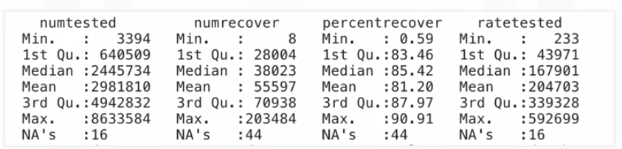
A History and a Literature Overview
Obtain a summary of descriptive statistics

Slide 6
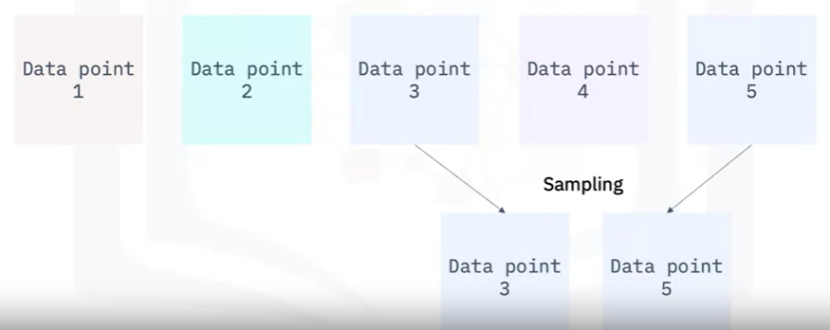
A History and a Literature Overview
Data sampling

Slide 7
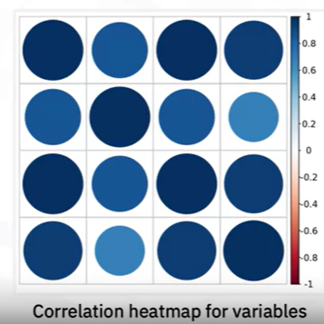
A History and a Literature Overview
Correlation analysis

Slide 8
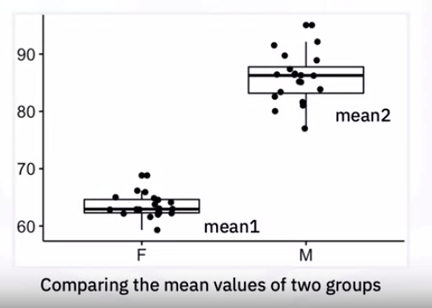
A History and a Literature Overview
Hypothesis testing

Slide 9
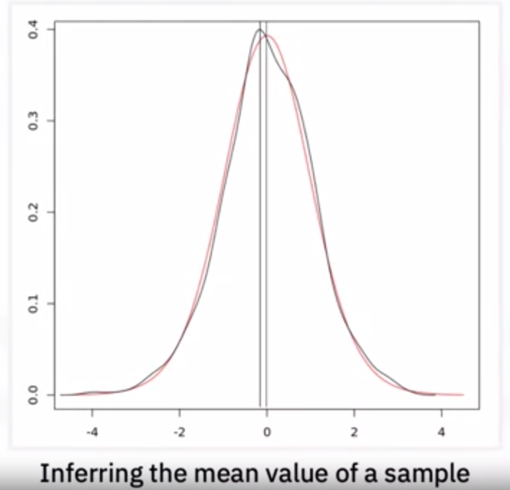
A History and a Literature Overview
Statistical inference

Slide 10
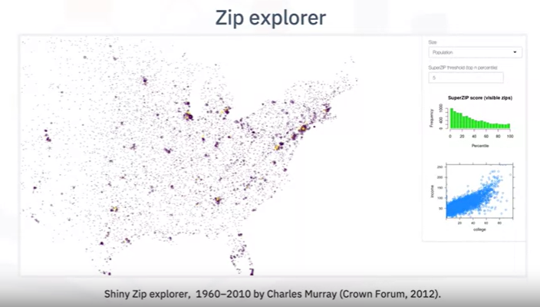
A History and a Literature Overview
Interactive and visual analytics
Dashboard

Slide 11
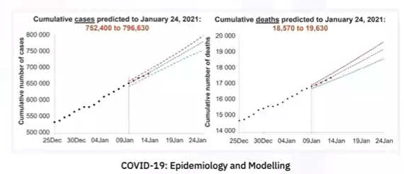
A History and a Literature Overview
Machine learning and AI tasks
  Predict pandemic trends

Slide 12
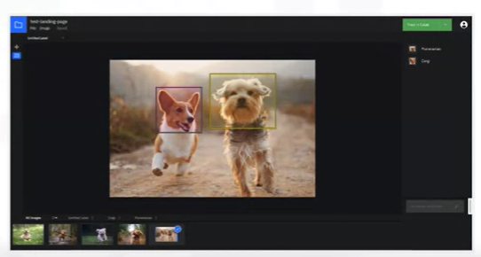
A History and a Literature Overview
Machine learning and AI tasks
  Recognize visual objects, such as dog breeds

Slide 13
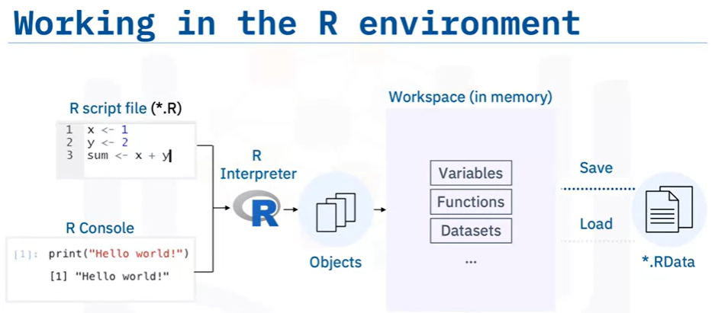
R Environment

Slide 14
R Environment
List all created R objects in workspace

Slide 15
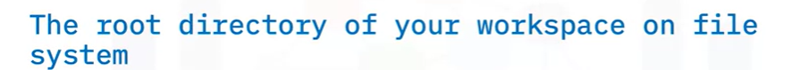

R Environment

Slide 16

R Environment

Slide 17
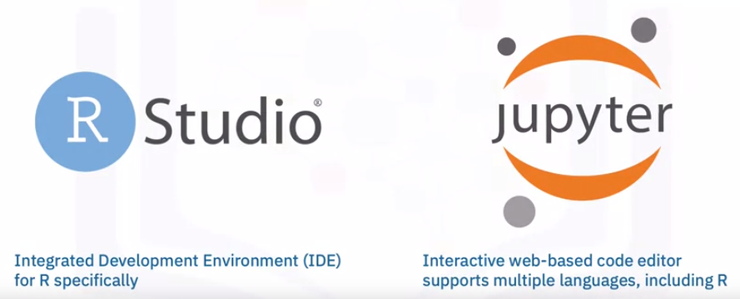
R Environment
Notes:
RStudio provides many features to help you with R development,
such as syntax highlighting, command history, workspace management, and direct code execution.
The Jupyter Notebook is an interactive web-based code editor that you can use to combine code,
data, experimental results, and narration together in a single notebook instance.
Jupyter Notebook is very efficient for experiments and prototyping,
as well as for educational purposes.

Slide 18
Summary
Explain the history, purpose of the R language and describe its main features
Explain R environment-related concepts, such as the R console, R script files, and workspaces
Describe two popular R development tools, RStudio and Jupyter Notebook.

Slide 19
Q & A
Chapter1- Importing Datasets

